Slide 1

BANK CUSTOMER CHURN ANALYSIS
PRESENTED BY
AVIRAJ MISHRA

Slide 2
AGENDA
INTRODUCTION
OBJECTIVES
DASHBOARD
QUESTIONS SOLVED
INSIGHITS
SUGGESTIONS AND RECOMMENDATIONS

Slide 3
INTRODUCTION
The dataset contains account information for 10,000 customers at a European bank. It includes key attributes such as:
Demographics: Age, Gender, and Geography (Germany, France, Spain)
Financial Metrics: Credit Score, Balance, and Estimated Salary
Account Activity: Number of Products, Tenure, and whether the customer has a Credit Card
Customer Behavior: Active membership status and whether they have exited (churned).
The purpose of this analysis is to identify patterns and insights that help understand customer churn, enabling the bank to improve customer retention strategies and increase profitability. Key questions explored include:
What factors most influence customer churn?
How do customer segments differ in their account behaviors?
Are there significant geographic or demographic trends in customer churn?
This analysis will be visualized using Power BI, with a focus on data-driven insights to support business decisions.

Slide 4
OBJECTIVES
1. Identify Key Factors Influencing Customer Churn
- Analyze customer data to determine which variables (age, credit score, geography, etc.) have the strongest impact on churn.
2. Segment Customers Based on Account Behavior
- Group customers into meaningful segments (e.g., by balance, tenure, and activity level) to understand behavior patterns.
3. Analyze Demographic Trend
- Examine how customer demographics (age, gender, geography) affect churn and account activity.
4. Understand Differences in Customer Behavior Across Regions
- Compare customer behavior in Germany, France, and Spain to uncover regional differences in churn and product usage.
5. Provide Actionable Insights for Reducing Churn
- Offer data-driven recommendations to help the bank improve customer retention strategies and enhance overall profitability.

Slide 5
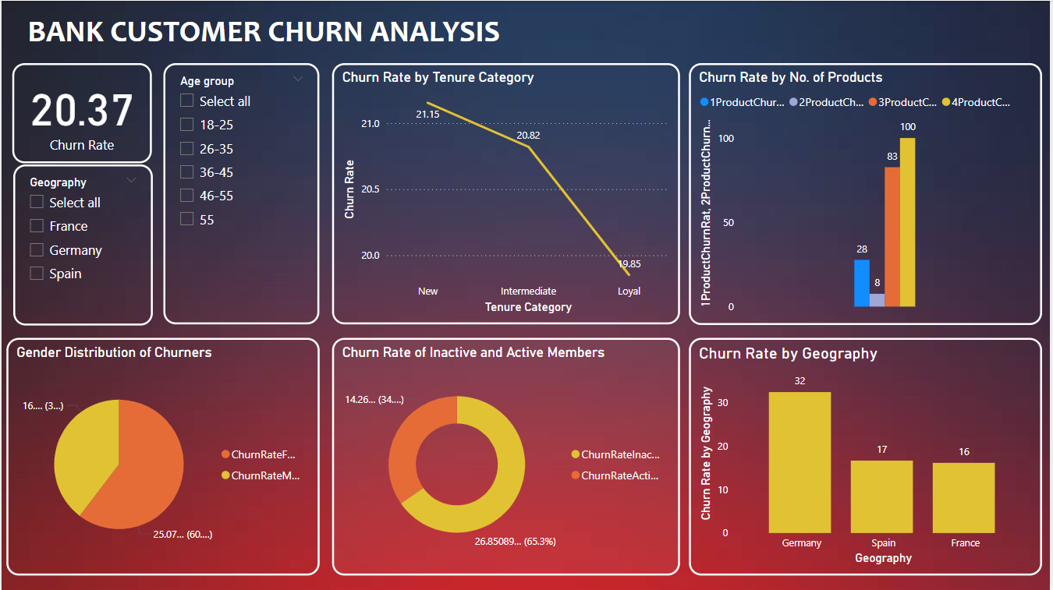

Slide 6
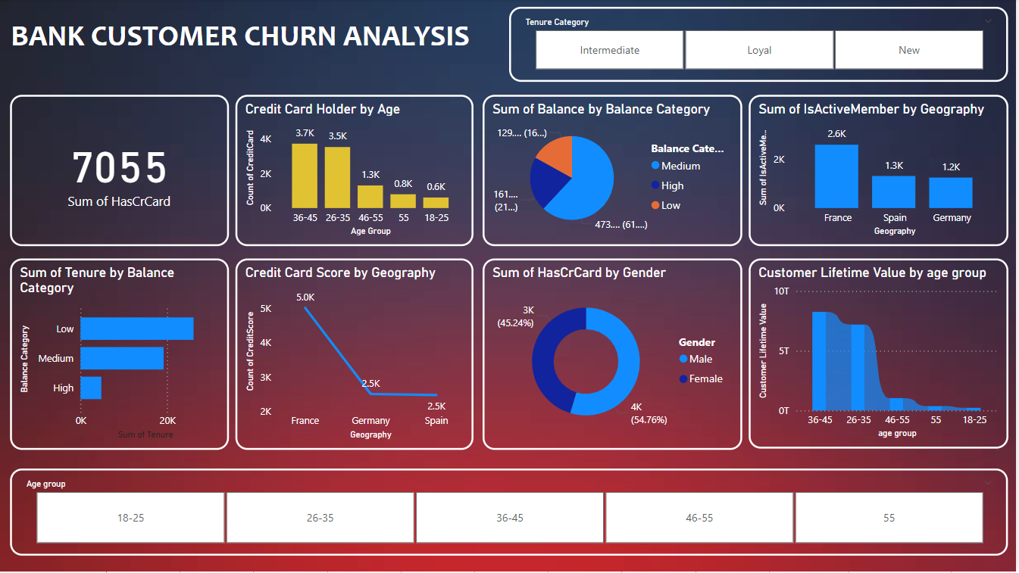

Slide 7
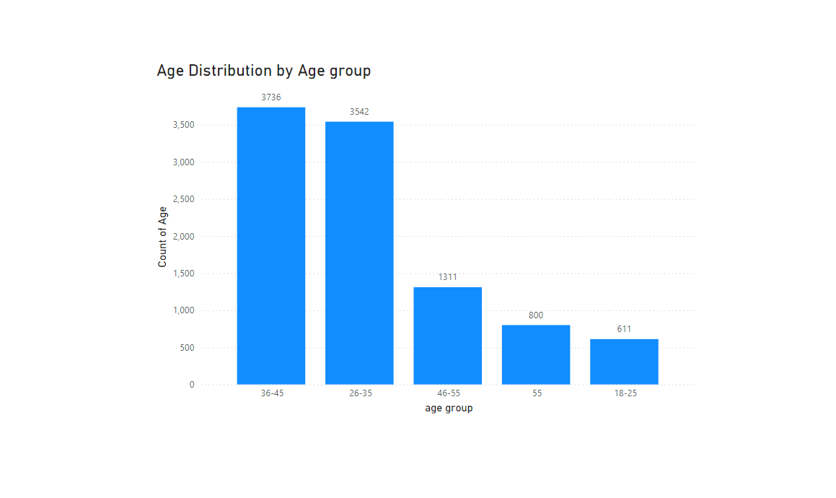
QUES 1. What is the age distribution of the bank's customers across different age groups?
INSIGHTS :-
The 36-45 age group has the largest number of customers (3,736), followed closely by the 26-35 age group (3,542).
Younger (18-25) and older (55+) customers represent smaller portions of the overall customer base, with most customers concentrated between 26 and 45 years old.
RECOMMENDATIONS :-
Target Retention Strategies for Key Age Groups.
Engage Younger Customers (18-25) by Offering student loans, first-time credit products, and targeted financial education could attract and retain this younger audience.
Focus on Older Customers (55+) by Offering retirement planning services, pension-related products, and personalized financial advice could be effective.

Slide 8
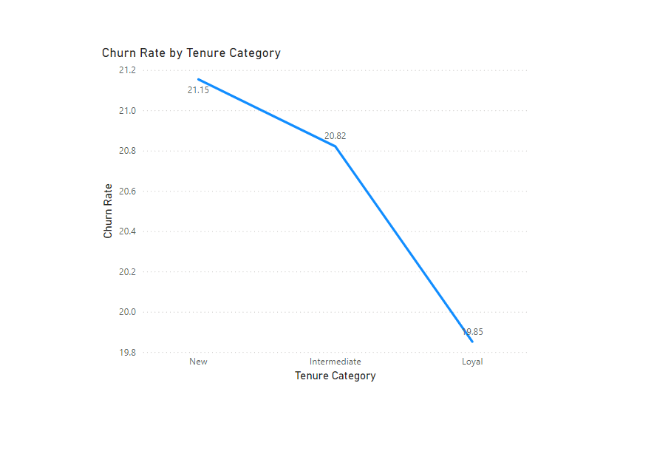
QUES 2. How does tenure affect churn rates?
INSIGHTS :-
The churn rate decreases as the tenure category increases, moving from "New" customers to "Loyal" customers.
This trend suggests that tenure plays a significant role in customer retention. The longer customers stay with the bank, the less likely they are to churn.
RECOMMENDATION :-
Focus on Retaining New Customers: Since new customers have the highest churn rate, the bank should develop targeted onboarding and retention strategies for this group.
Build Loyalty Programs: Strengthen loyalty programs for intermediate and long-term customers to further decrease churn as they progress through their tenure.

Slide 9
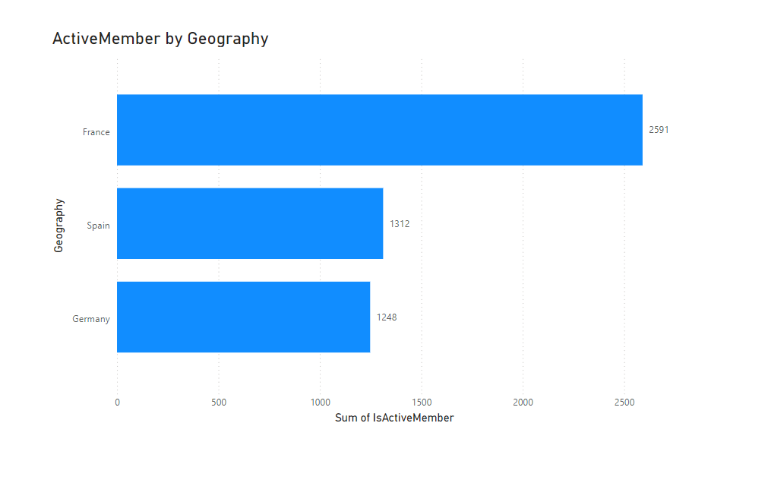
QUES 3. How does customer activity (active vs. inactive) vary by geography (Germany, France, Spain)?
INSIGHTS :-
France has the highest number of active members (2,591), significantly more than Spain (1,312) and Germany (1,248).
This suggests that customers in France are more engaged or satisfied with the bank's services compared to customers in Spain and Germany.
RECOMMENDATION :-
Investigate France’s Success
Targeted Campaigns for Spain and Germany
Customer Feedback and Service Improvement

Slide 10
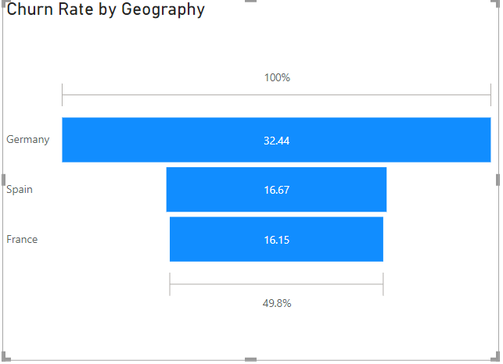
QUES 4. How does customer churn vary by geography (Germany, France, Spain)?
INSIGHTS :-
Germany has the highest churn rate at 32.44%, more than double the churn rates in Spain (16.67%) and France (16.15%).
This suggests that German customers are significantly more likely to leave the bank compared to customers in Spain and France.
RECOMMENDATION :-
Investigate Reasons for High Churn in Germany
Implement Retention Strategies for Germany
Monitor and Compare Competitor Offerings
Focus on Engagement and Customer Support

Slide 11
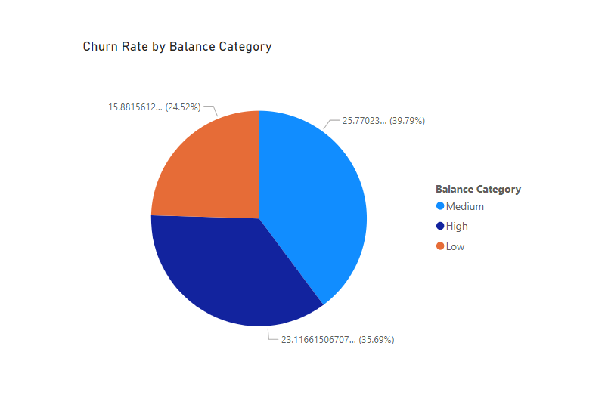
QUES 5. What is the relationship between balance and churn?
INSIGHTS :-
Medium-Balance customers have the highest churn rate.
High-Balance customers are also at a significant risk.
Low-Balance customers churn the least.
RECOMMENDATIONS :-
Segment-Specific retention strategies.
Analyze customer behavior.
Since high-balance customers may have a greater impact on revenue, offering them premium services, priority support, or financial advising could help reduce their churn.
Monitor Low – Balance churn.

Slide 12
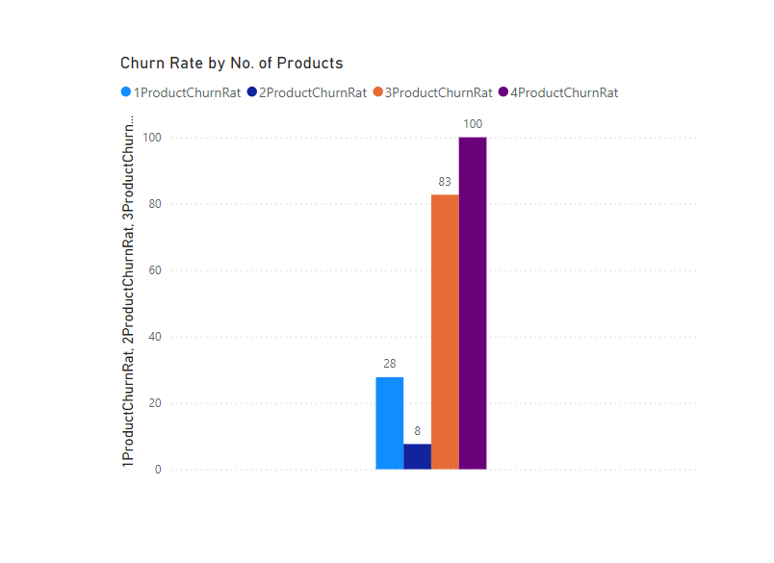
QUES 6. How does the number of products affect churn?
INSIGHTS :-
The churn rate increases dramatically as the number of product increases.
Customers with fewer products (1 or 2) are less likely to churn.
High product engagement ( 3 or more products) correlates with a much higher churn rate.
RECOMMENDATIONS :-
Investigate the customer experience for multi-product users.
Simplify Product Offerings.
Targeted Retention for multi-product customers.

Slide 13
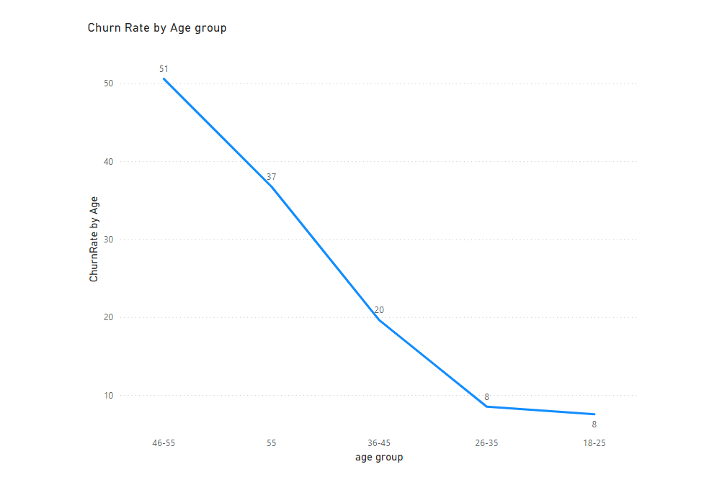
QUES 7. Which age group has the highest churn rate?
INSIGHTS :-
As it is visible that age group ‘46-55’ that is low engaged retirees are more likely to churn.
Whereas age group of ‘18-25’ has the least churn rate.
RECOMMENDATIONS :-
The older age group (46-55) is at a higher risk of churn. Investigate whether the offerings are less appealing or if there are other factors like technology discomfort.
Focus retention strategies on this age group, such as offering more personalized products or support.
The younger age groups (18-25 and 26-35) show strong retention. Continue to engage this demographic with relevant content and services.

Slide 14
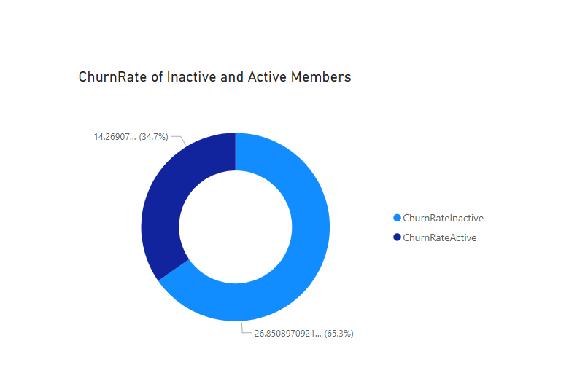
QUES 8. Is there a difference in churn based on customer activity (active member vs. inactive)?
INSIGHTS :-
Churn Rate Inactive : 65.3%, meaning the majority of churn is coming from inactive members.
Churn Rate Active : 34.7%, a smaller portion but still significant.
RECOMMENDATIONS :-
It’s crucial to identify why such a high percentage of Inactive members are churning. Conduct further analysis on Inactive users’ behavior leading to churn.
Implement targeted retention strategies for both groups, with more focus on Inactive members since they make up the majority of churn.

Slide 15
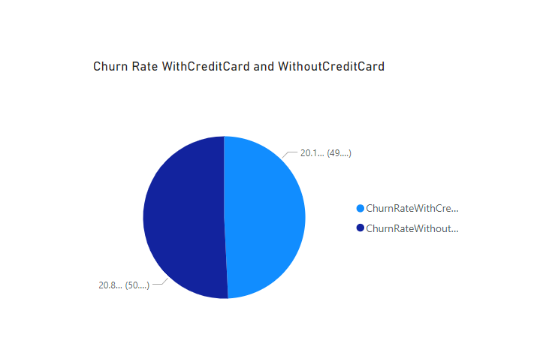
QUES 9. What percentage of churners have a credit card vs. those who don't?
INSIGHTS :-
Churn Rate Similarity : It indicates that having a credit card does not significantly impact the likelihood of churn.
Balanced Distribution : This suggests that other factors might be influencing churn more than credit card ownership.
RECOMMENDATIONS :-
Investigate Other Factors.
Targeted Retention Strategies like personalized offers or loyalty programs to both groups.
Customer Feedback to identify specific points and areas for improvement.
Monitor churn rates and other relevant metrics to identify any emerging trends.

Slide 16
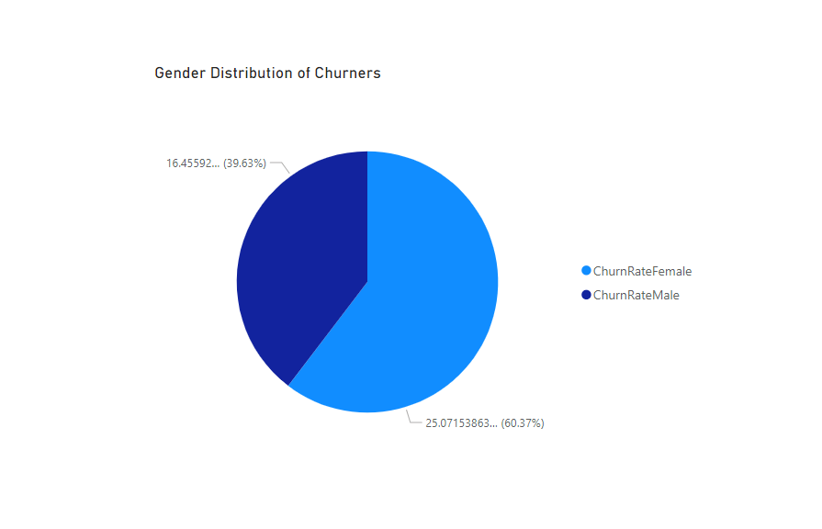
QUES 10. What is the gender distribution of churners?
INSIGHTS :-
60.37% of the churners are female, while 39.63% are male.
The gender imbalance in churn rates suggests that female customers may be more prone to dissatisfaction or have different needs that are not being met by the bank compared to male customers.
RECOMMENDATIONS :-
Investigate Female Customer Needs
Create Female-Centric Banking Solutions
Monitor and Adjust Retention Strategies
Balance the Customer Experience for Both Genders

Slide 17
INSIGHTS
Gender Distribution of Churners :- 60.37% of churners are female, This shows that a higher proportion of women tend to leave the bank compared to men.
Churn Rate by Age Group :- The highest churn rate is in the 46-55 age group at 51%, followed by the 36-45 age group at 37%. The churn rate decreases significantly for younger groups, with both the groups at 8%.
Churn Rate by Number of Products :- Customers with 4 products have the highest churn rate at 100%, followed by those with 3 products at 83%. Those with 2 products show a churn rate of 28%, and customers with only 1 product have a churn rate of 8%.
Churn Rate of Active vs Inactive Members :- 65.3% of churners were inactive members, while 34.7% were active members. Inactive members make up the majority of those who churn.
Churn Rate with and Without Credit Cards :- The churn rate is nearly even between customers with and without credit cards, with 50.2% without credit cards and 49.8% with credit cards.
Churn Rate by Tenure Category :- The churn rate decreases as the tenure category increases, moving from "New" customers to "Loyal" customers. This trend suggests that tenure plays a significant role in customer retention. The longer customers stay with the bank, the less likely they are to churn.

Slide 18
SUGGESTIONS AND RECOMMENDATIONS
Gender-Specific Retention Strategies :- Focus more retention efforts on female customers by offering personalized services, tailored financial products, and improved customer engagement to reduce the higher churn rate in this group.
Engagement with Older Customers :- The bank should prioritize engagement with customers aged 46-55 and 36-45, as these groups have significantly higher churn rates. Offering financial planning services, retirement advice, or loyalty programs could help retain these older customers.
Product Bundling to Prevent Churn :- Customers with 3 or more products show the highest churn rates, suggesting that these customers may feel overwhelmed or dissatisfied. Offering better product bundling options, streamlining the management of multiple products, or providing exclusive offers for loyal customers may reduce churn in this group.
Re-engage Inactive Members :- Conduct satisfaction surveys to identify specific areas of dissatisfaction among inactive members and use predictive models to intervene early with targeted incentives or loyalty rewards.
Promote Credit Card Benefits :- Since churn rates are evenly split between customers with and without credit cards, develop targeted marketing campaigns to demonstrate the benefits of having a credit card. This could include better rewards programs, personalized offers, or improved customer support for cardholders.
Offer Cross-Sell Products :- Since customers with only one product have a lower churn rate, the bank should focus on cross-selling additional products to customers with fewer services. This strategy can enhance customer retention by increasing customer dependency on the bank for multiple financial needs.

Slide 19


